Slide 1
LOAN ANALYSIS USING EXCEL, POWER BI, TABLEAU & MYSQL
BANK ANALYTICS PROJECT
Group Number: 6
Start

Slide 2
Problem Statement
Financial institutions rely on accurate loan analysis to make informed decisions about approvals, interest rates, and repayment plans. The dataset contains borrower details such as loan amount, interest rate, verification status, payment behaviour, and demographics.
This project focuses on analysing loan trends, assessing customer risk levels, and studying repayment behaviour across different borrower profiles to optimize lending strategies and reduce defaults.

Slide 3
Objectives of the Project
  Identify year-wise and month-wise loan disbursement patterns
  Analyse impact of verification status on repayments
  Understand borrower risk using grade and sub-grade segmentation
  Examine effect of home ownership on repayment duration
  Compare loan status across states to study geographic performance

Slide 4
Dataset & Data Cleaning
Dataset Details
Data Cleaning Steps
  Removed duplicates
  Handled null & blank values
  Fixed inconsistent date formats (converted to Year–Month)
  Standardised grade, sub-grade & home ownership
  Created derived fields:
  repayment duration
  revolving balance
  payment difference etc
  Banking & Loan customer dataset
  Includes: state, loan amount, verification, interest rate, ownership, grade, payment history etc

Slide 5
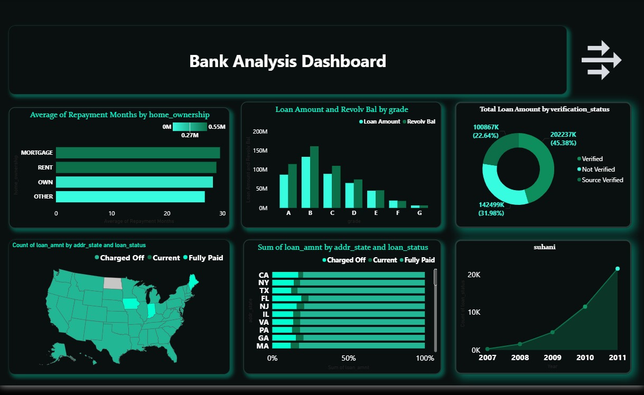
Interactive visuals using DAX, filters, drill-through and financial KPIs.
Loan Analysis Dashboard (Power BI)

Slide 6
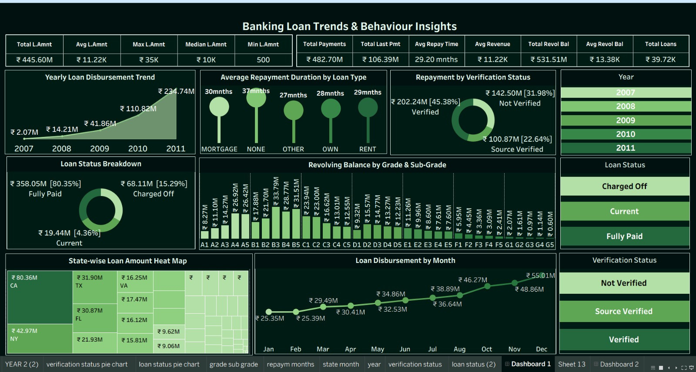
Loan Insights Dashboard (Tableau)
Story-driven visualization focusing on loan trends, grade breakdown & state-wise performance.

Slide 7
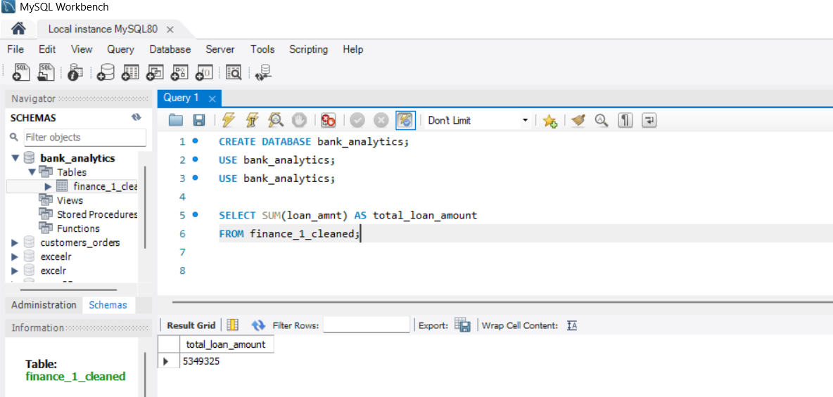
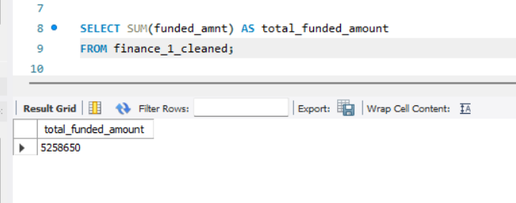
MySQL Queries Used
1. Total Loan Amount Issued
2. Total Funded Amount

Slide 8
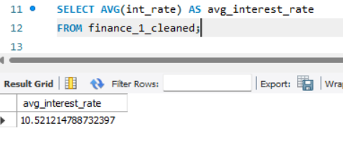
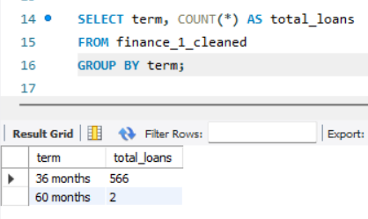
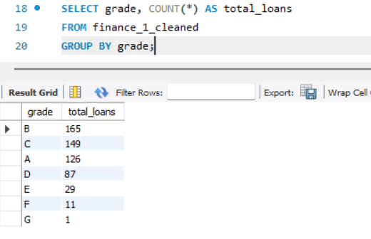
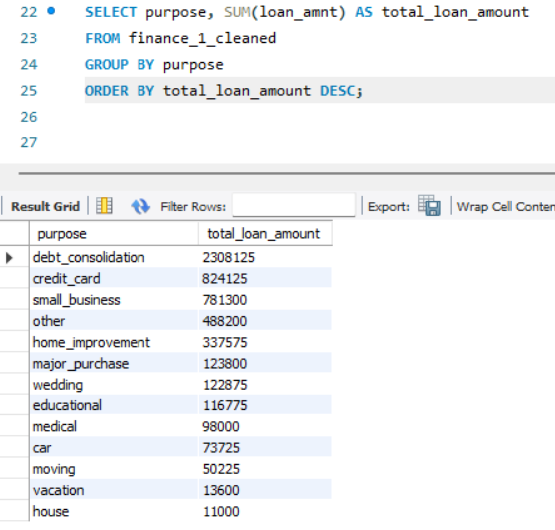
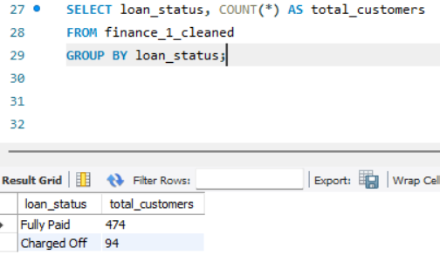
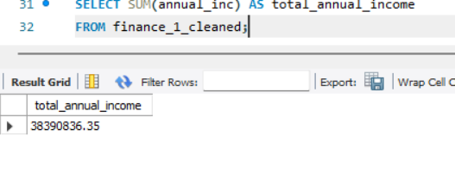
3. Average Interest Rate
4. Average Loan Term (in months)
5. Loan Count by Grade
6. Loan Amount by Purpose
7. Loan Status Summary (KPI for dashboard)
8. Total Annual Income of Borrowers

Slide 9
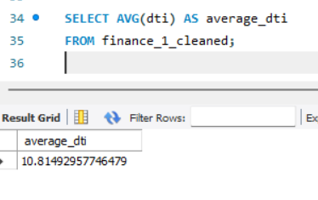
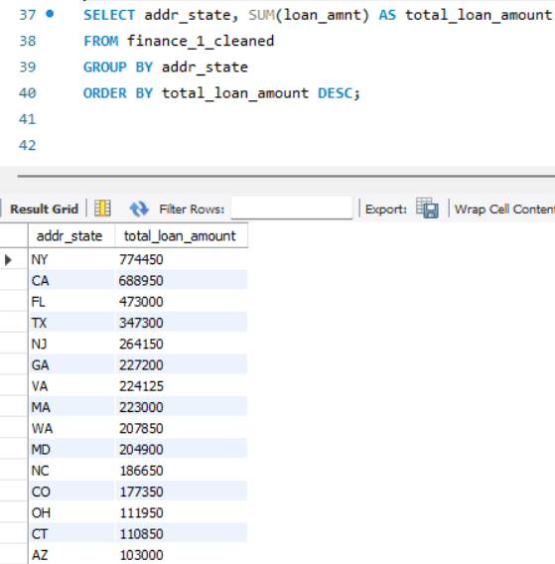
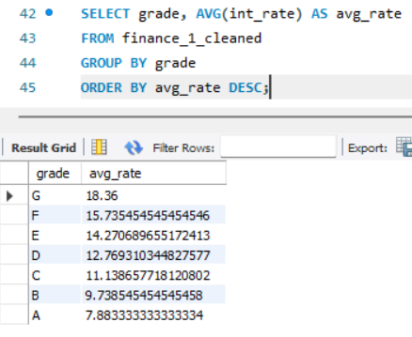
9. Average DTI (Debt-to-Income Ratio)
10. Loan Amount by State
11. Interest Rate by Grade

Slide 10
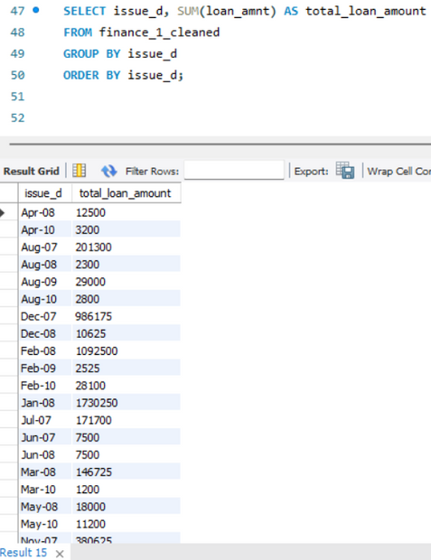
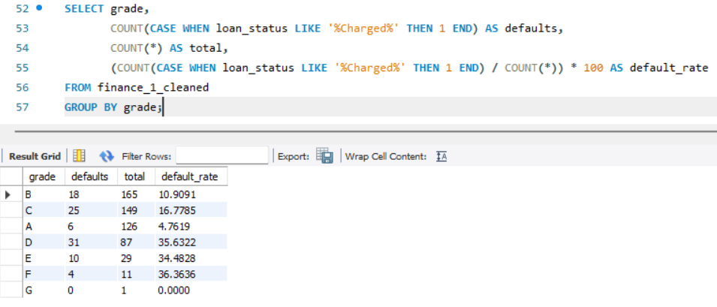
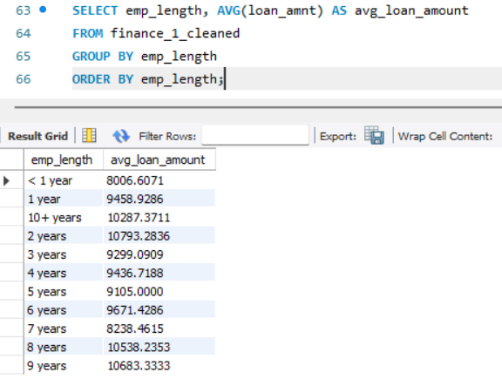
12. Loan Volume Over Time (by issue date)
13. Default Rate by Grade
14. Employment Length Impact

Slide 11
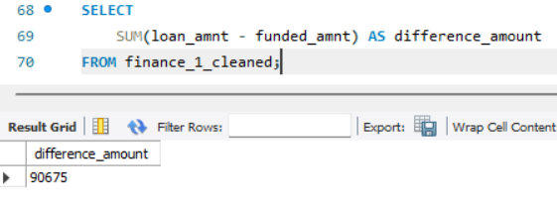
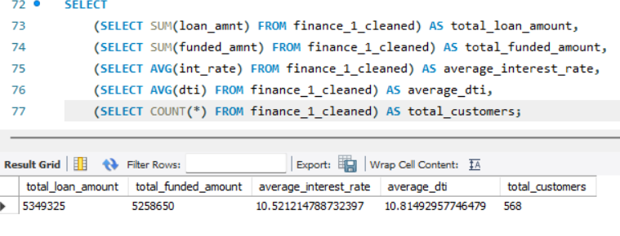
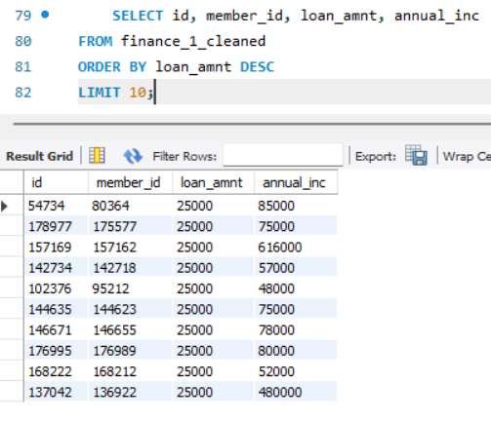
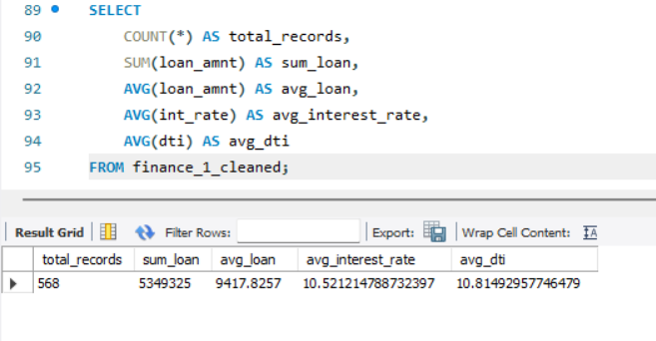
Funded Amount vs Loan Amount Difference
KPI Query Set (for dashboard filters)
Top 10 High-Value Borrowers
Full Data Summary

Slide 12
Recommendations for Banks
💡 Increase loan allocation to mid-risk segments (Grades B & C)
💡 Encourage verified applications to minimise repayment uncertainty
💡 Provide personalised repayment plans for mortgage borrowers
💡 Strengthen credit monitoring in low-performing states
💡 Design targeted strategies for non-verified & low-grade borrowers

Slide 13
Thank You For Attention

